Slide 1
강화학습실제
2024254016 이기명

Slide 2
1. Hyperparameter
self.gamma = 0.98 self.lr = 0.0005 self.buffer_size = 10000 self.batch_size = 32 self.action_size = 3 # 0: 왼쪽, 1: 정지, 2: 오른쪽 # Epsilon-greedy 설정 self.epsilon_start = 0.2 self.epsilon_end = 0.05 self.epsilon_decay = 1 self.epsilon = self.epsilon_start

Slide 3
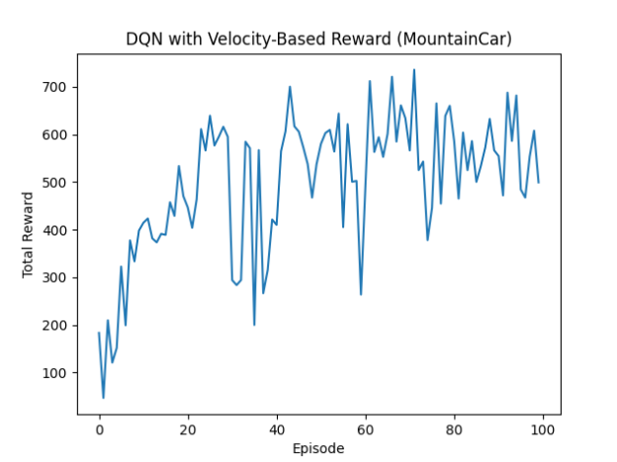
2. Epsilon 0.17일때
Episode 0, Total Reward: 183.02, Epsilon: 0.170
Episode 10, Total Reward: 414.44, Epsilon: 0.170
Episode 20, Total Reward: 446.68, Epsilon: 0.170
Episode 30, Total Reward: 293.87, Epsilon: 0.170
Episode 40, Total Reward: 410.03, Epsilon: 0.170
Episode 50, Total Reward: 580.40, Epsilon: 0.170
Episode 60, Total Reward: 491.41, Epsilon: 0.170
Episode 70, Total Reward: 566.46, Epsilon: 0.170
Episode 80, Total Reward: 585.51, Epsilon: 0.170
Episode 90, Total Reward: 554.69, Epsilon: 0.170
목표 도달 횟수: 52 / 100
Total Reward: -114.0

Slide 4
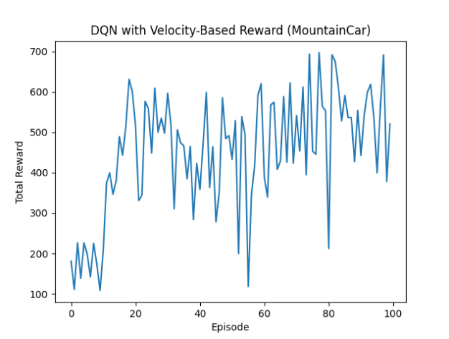
2. Epsilon 0.3일때
Episode 0, Total Reward: 180.87, Epsilon: 0.300
Episode 10, Total Reward: 208.97, Epsilon: 0.300
Episode 20, Total Reward: 517.03, Epsilon: 0.300
Episode 30, Total Reward: 595.99, Epsilon: 0.300
Episode 40, Total Reward: 358.49, Epsilon: 0.300
Episode 50, Total Reward: 432.74, Epsilon: 0.300
Episode 60, Total Reward: 387.60, Epsilon: 0.300
Episode 70, Total Reward: 541.21, Epsilon: 0.300
Episode 80, Total Reward: 211.87, Epsilon: 0.300
Episode 90, Total Reward: 441.96, Epsilon: 0.300
목표 도달 횟수: 39 / 100

Slide 5
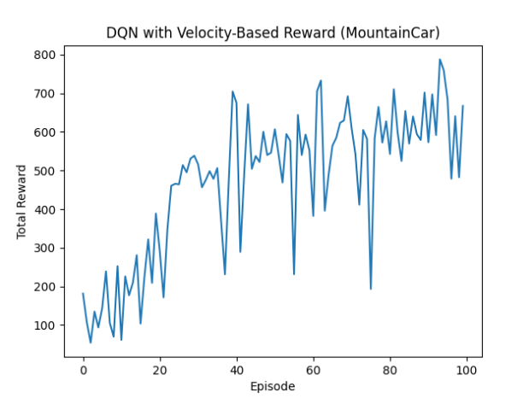
2. Epsilon 0.1일때
Episode 0, Total Reward: 181.28, Epsilon: 0.100
Episode 10, Total Reward: 61.30, Epsilon: 0.100
Episode 20, Total Reward: 292.64, Epsilon: 0.100
Episode 30, Total Reward: 515.87, Epsilon: 0.100
Episode 40, Total Reward: 675.18, Epsilon: 0.100
Episode 50, Total Reward: 606.90, Epsilon: 0.100
Episode 60, Total Reward: 382.42, Epsilon: 0.100
Episode 70, Total Reward: 609.80, Epsilon: 0.100
Episode 80, Total Reward: 542.85, Epsilon: 0.100
Episode 90, Total Reward: 573.20, Epsilon: 0.100
목표 도달 횟수: 57 / 100
Total Reward: -111.0

Slide 6
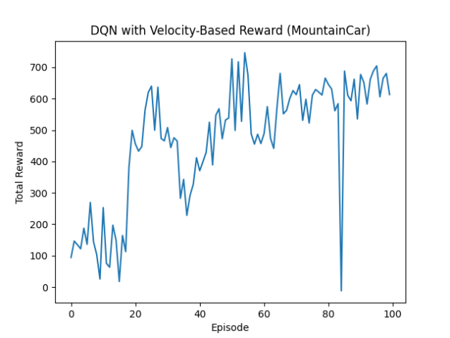
2. Epsilon 0.13일때
Episode 0, Total Reward: 93.93, Epsilon: 0.130
Episode 10, Total Reward: 252.77, Epsilon: 0.130
Episode 20, Total Reward: 455.84, Epsilon: 0.130
Episode 30, Total Reward: 507.94, Epsilon: 0.130
Episode 40, Total Reward: 370.41, Epsilon: 0.130
Episode 50, Total Reward: 726.55, Epsilon: 0.130
Episode 60, Total Reward: 488.85, Epsilon: 0.130
Episode 70, Total Reward: 612.63, Epsilon: 0.130
Episode 80, Total Reward: 644.97, Epsilon: 0.130
Episode 90, Total Reward: 676.98, Epsilon: 0.130
목표 도달 횟수: 57 / 100
Total Reward: -152.0

Slide 7
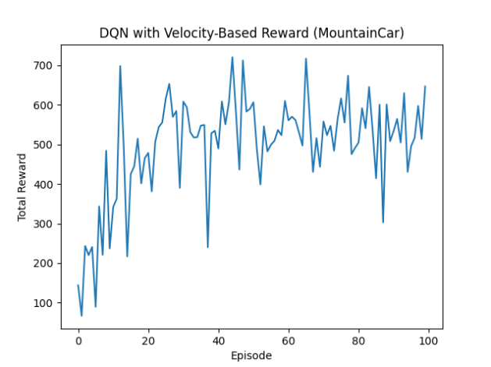
2. Epsilon 0.2일때
Episode 0, Total Reward: 143.87, Epsilon: 0.200
Episode 10, Total Reward: 341.90, Epsilon: 0.200
Episode 20, Total Reward: 478.68, Epsilon: 0.200
Episode 30, Total Reward: 608.24, Epsilon: 0.200
Episode 40, Total Reward: 489.88, Epsilon: 0.200
Episode 50, Total Reward: 606.68, Epsilon: 0.200
Episode 60, Total Reward: 560.79, Epsilon: 0.200
Episode 70, Total Reward: 557.97, Epsilon: 0.200
Episode 80, Total Reward: 504.91, Epsilon: 0.200
Episode 90, Total Reward: 533.88, Epsilon: 0.200
목표 도달 횟수: 61 / 100
Total Reward: -111.0

Slide 8
결과
Episode가 100일 때 epsilon 0.2가 가장 학습능력이 좋았음.

